Slide 1
56th NCDA Annual Conference Best Practices for your Action Plan Salt Lake City, UT | June 11

Slide 2
Annual Action Plan
One-year plan to allocate federal funding from HUD
Identifies projects to be funded during the Program Year (Oct. 1, 2025 – Sept. 30, 2026)
Projects are selected based on funding eligibility and the five-year goals and priority needs of the Consolidated Plan

Slide 3
Annual Action Plan IDIS Sections
The AAP in IDIS has 17 sections
SETUP | AD-26 Administration
 | AD-50 Verify Grantee/PJ Information in IDIS
 | AD-55 Verify Grantee/PJ - Program Contacts
PROCESS | AP-05 Executive Summary
 | PR-05 Lead & Responsible Agencies
 | AP-10 Consultation
 | AP-12 Participation
ANNUAL ACTION PLAN | AP-15 Expected Resources
 | AP-20 Annual Goals and Objectives
 | AP-35 Projects
 | AP-50 Geographic Distribution
 | AP-55 Affordable Housing
 | AP-60 Public Housing
 | AP-65 Homeless and Other Special Needs Activities
 | AP-75 Barriers to affordable housing
 | AP-85 Other Actions
 | AP-90 Program Specific Requirements

Slide 4
Consultation and Participation
Develop mailing lists to inform partnering agencies and residents of opportunities to participate
Leverage social media and the County newsletter
Foster a good relationship with the local Housing Authority and the Continuum of Care.
Suggestions on what works for our program:
Conduct community meetings to obtain input on needed projects early on:
Housing Authority Board Meeting
Affordable Housing Advisory Board
Homeless services providers’ monthly meetings/CoC Leadership meetings
Combine Public Hearing with Application Workshop
Focus group with other City/County Depts/Divisions that serve our target population and low-income neighborhoods (health services, public safety, schools, DPW…)

Slide 5
AAP Process Schedule
January - March | Community Meetings & Focus Groups
March 3 | Public Hearing & Grant Application Workshop
Mar 3 – April 4 | Application Period
April 5 – May 12 | Review Committee evaluations and recommendations to the Board of County Commissioners
June 3 | Board of County Commissioners preliminary decisions for approved projects to be included in FY 2025 Annual Action Plan
June 30 – July 29 | 30-day Public Comment Period for FY 2025 Annual Action Plan draft
July 29 | Board of County Commissioners Final Public Hearing and Adoption of FY 2025 Annual Action Plan
August 16 | Deadline for Plan Submission to HUD
Oct 1-25 – Sept 30-26 | FY 2025 Annual Action Plan Performance Period

Slide 6
Application Process / Workshop Agenda
New Trump Administration / HUD
County General Priorities
Funding Sources
FY 2025 CDBG, HOME & ESG
CDBG-CV
HOME-ARP
ESG-RUSH
Application Process & Sections
Federal Requirements
Schedule from Application to Implementation
Scoring Criteria
Selected Projects Requirements
Questions and Closing

Slide 7
PROJECT-BASED PROGRAM
Applications through Neighborly
Com Dev funds are primarily envisioned for:
One-time assistance - not ongoing funding
Direct and specific scope
Specific site acquisition
One-time assistance to a household for one type of service
COMMON APPLICATION MISTAKES:
Application for two different services: acquire a space and provide service/rental assistance.
Request funds for the agency to operate (general salaries, office lease…)

Slide 8
APPLICATION SECTIONS
PROJECT ELIGIBILITY
Section A: Agency Information
Section B: Project Information
Section C: Performance Measures
Section D: Other Requirements
Section E: Schedule
Section F: Detailed Budget

Slide 9
2025 Applications and Scoring
Review Committee – 8-10 reviewers
Maximum Points – 100; Min Average Scoring Required for Award Consideration – 60
Scoring Criteria
LMI SERVICE AND CONSOLIDATED PLAN ALIGNMENT - 9 Points
RATING OF AGENCY CAPACITY - 22 Points
RATING OF PROPOSED PROJECT - 26 Points
RATING OF PERFORMANCE MEASURES AND COLLABORATIONS – 23 Points
FUNDING REQUEST, LEVERAGING AND BUDGET NARRATIVE - 20 Points
Other determinants for Recommendations
Alignment with grant rules and objectives
Availability of funding
Project readiness and feasibility
Past performance & current open contracts/funding

Slide 10
Scoring Committee Composition
Fiscal Services
Affordable Housing
Children Services
Neighborhood Services
Homeless Project Manager
Criminal Justice Policy Coordinator
Compliance Services
Continuum of Care Representative
Housing Authority Representative
Future Improvements during the application process:
Hold a second online Application Workshop session
Hold a Q&A session during the application period
Have applicants present to the Scoring Committee on their projects
(5-10 min presentations)

Slide 11
Recommended Projects
Community Development Division presents the recommendations to the Board of County Commissioners for initial vote
Suggestion on what works for our program:
Be attuned to your Board’s priorities
Present project information in a concise and digestible way
Brief description
Eligibility
Targeted outcome (Goal Outcome Indicator / Matrix Code exercise)
Past year funding/current request/suggested award
Present denied projects based on non-compliance with grant requirements or unavailability of funding.
Include alternate projects in case any selected project cannot move forward

Slide 12
Annual Action Plan Draft
Projects are included in the Draft Annual Action Plan following the Board’s initial approval
Required coordination with CoC and Housing Authority may be achieved by including representatives on the Application Scoring Committee, and consulting with their Board/leadership council during consultation
Request their assistance when drafting narratives for AP-60 Public Housing, AP-65 Homeless and Other Special Needs Activities & AP-90 Program Specific Requirements

Slide 13
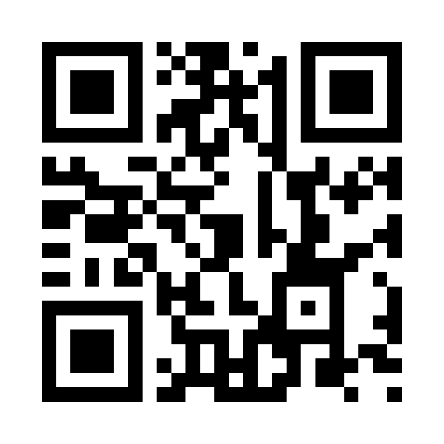
30-Day Public Comment Period
Draft Annual Action Plan is released for 30-day public comment period
Post a notice on your website, newspaper, and send it to your mailing list
Make the plan available at the Website and paper copies at local Libraries
Intentional outreach for comments:
Traditional methods: phone, letter, email & fax
Comment boxes next to paper copies of draft Plans
Online survey and QR code for easy access:

Slide 14
Annual Action Plan Submission
Final Public Hearing and Plan Adoption with the Board after the 30-day public comment period
Present a brief overview of the Plan and describe any comments received
Board to vote on adopting the Plan and authorizing submission to HUD
Suggestion on what works for our program:
Resolution approving the projects also authorizing the Director or appointee to approve ERR, execute agreements and amendments, to streamline project/activity implementation and avoid always having to go back to the Board for minor changes to specific activities

Slide 15
Questions Contact Julia Vieira Julia.Vieira@mymanatee.org (941) 748-4501 Ext. 1266

